Slide 1


Slide 2
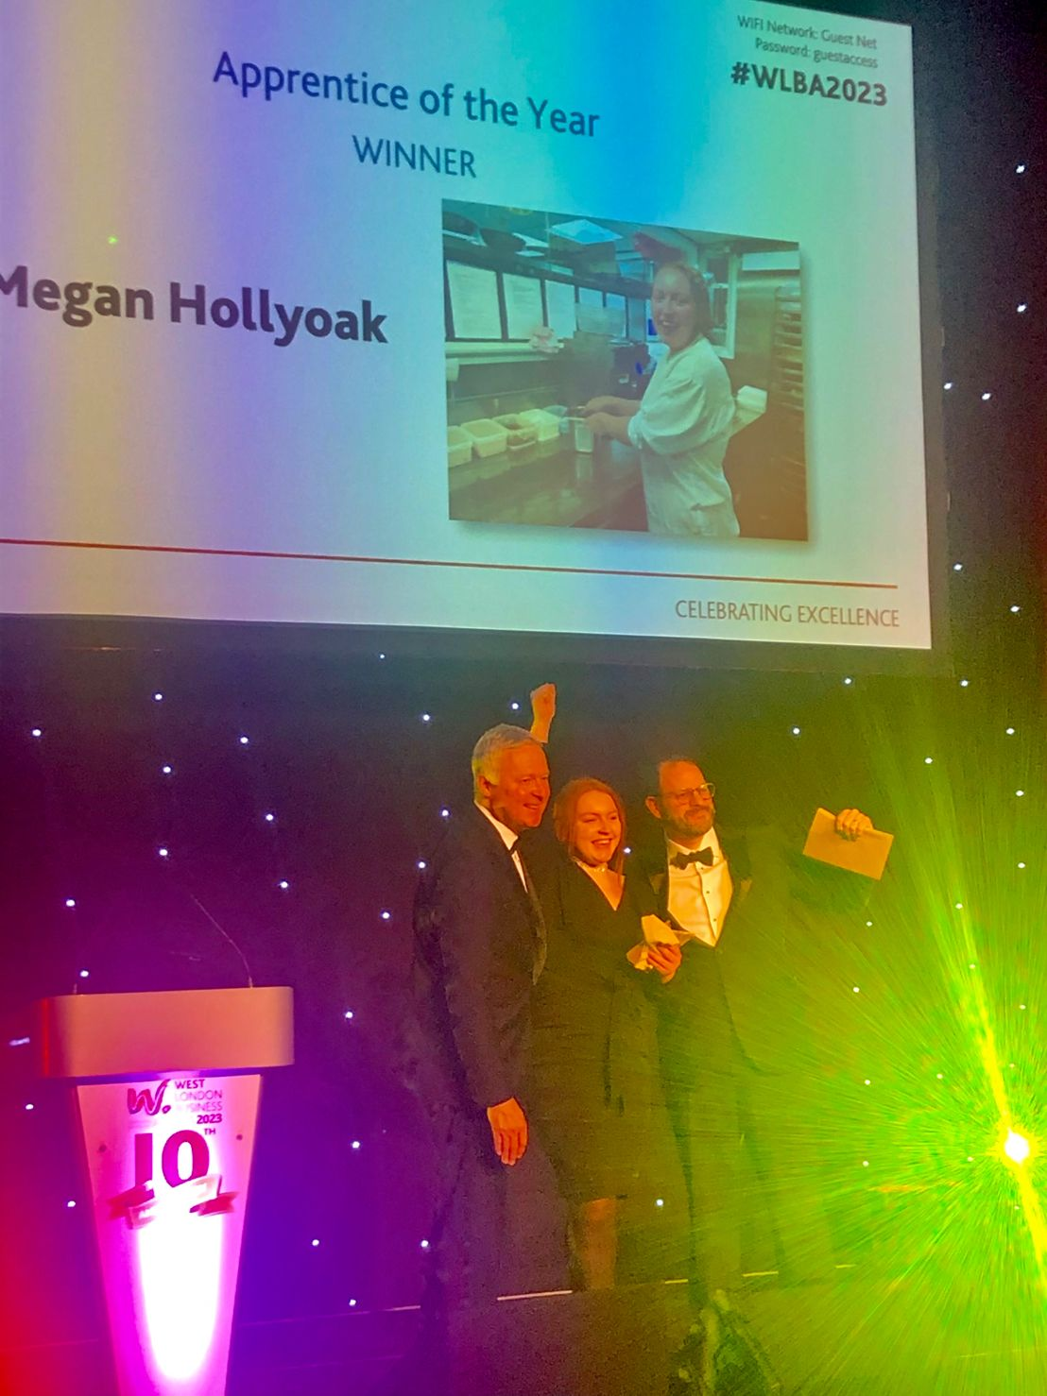
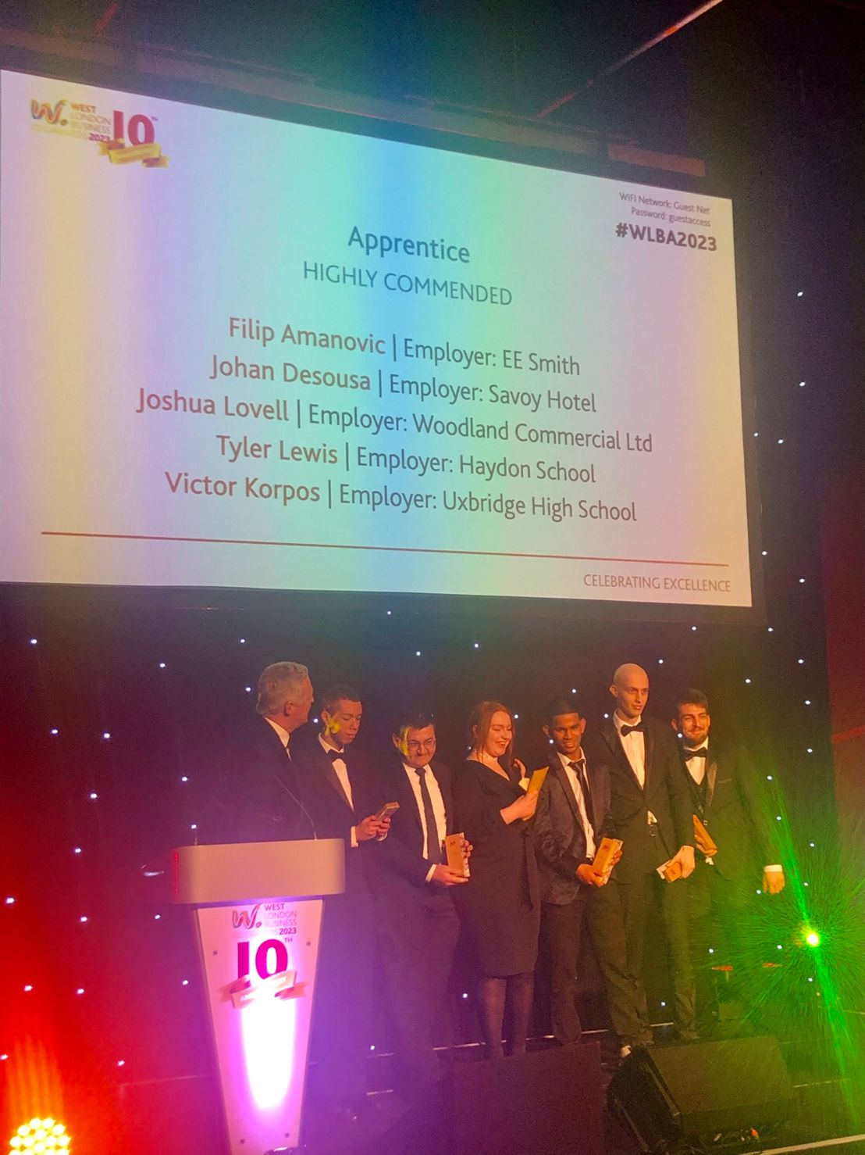
Our Apprentices are doing some amazing things!

Slide 3


Our Apprentices are doing some
amazing things!
Our apprentice, Tyler, won a
gold medal at WorldSkills.
This is a prestigious Olympic style competition for apprentices across the country to showcase their skills!

Slide 4
HRUC Apprenticeship Offer
Accounting (L2, L3, L4) ​
Accounting Taxation Technician (L4)
Autocare Technician ​(L2)
Business Administration ​(L3)
Bus and Coach Apprenticeship (L3) with Metroline
Carpentry and Joinery (L2/L3)
Chef de Partie (L3)
Childcare/Early Years ​(L2, L3)
Commis / Production Chef​ (L2)
Community Sports Activator (L2)
Construction Site Technician (L4)
Customer Service – Practitioner and Specialist ​(L2/L3)
Dental Nursing ​(L3)
Digital Marketer (L3)
Electrical Installation (L3)
Engineering – Design & Draughting Person (L3)
Engineering – Automation & Control (L4)
Engineering – Digital (Construction) (L3)
Engineering – Project Control (L3)
Engineering – Machinist Advanced Manufacturing (L4)
Engineering – Maintenance and Operations (L3)
Engineering – Mechatronics Maintenance (L3)
Engineering – Technical Support (L3)
Hairdressing (L2, L3)
​Health & Social Care ​ (L2 & L3)​
Human Resources​ (L3)
IT Solutions​ Technician (L3)
Lab Technician (L3)
Motor Vehicle – Maintenance & Repair​ (L3)
Network Engineer (L4)
Oral Hygiene Practitioner (L4)
People Professional (L5)
Plumbing & Heating​ (L3)​
Production Chef (L2)
Property Maintenance Operative (L2)
Operational Departmental Manager (L5)​
Teaching Assistant (L3)
Team Leading (L3)

Slide 5
The application and assessment process
Apply online - HCUC website, NAS, Not Going to Uni
Interview & Assessment (2-parts)
1st part – BKSB & Documents - Passport/residence card, GCSE certificates and CV
2nd part – Interview with curriculum assessor & Skills Scan
If approved by the assessor, your CV will go out to available employers
If shortlisted for a job interview, we’ll arrange it with you
If successful at the interview, employer will offer you the job role
The college will enrol you onto the apprenticeship training programme / complete apprenticeship contracts

Slide 6
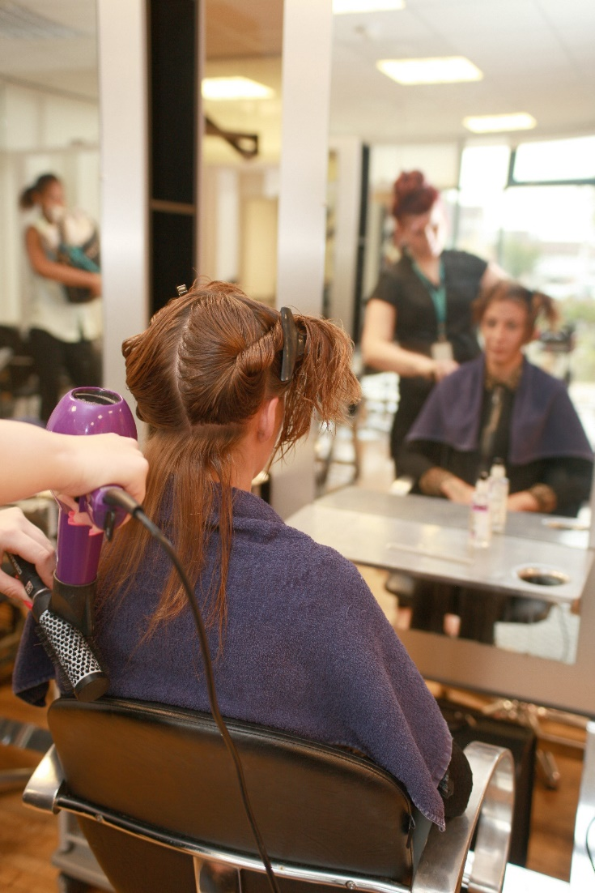
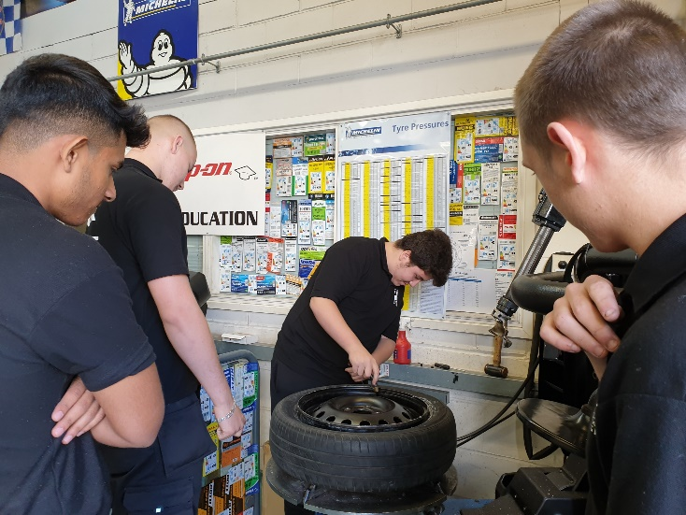
During your apprenticeship programme
You will be appointed an assessor from college who visits you at work every 8 weeks
Your assessor and work place mentor provides specialist support
You’ll attend college, usually for one day per week
You are responsible for your own learning (self-study)
At the end of your apprenticeship, you’ll be assessed by an external assessor - End Point Assessment (EPA)

Slide 7




How to find Apprenticeship Vacancies?
Discover our apprenticeship opportunities on all the platforms below
National apprentice service -
Find an apprenticeship - GOV.UK (www.gov.uk)
NotGoingToUni -
NGTU | Home (notgoingtouni.co.uk)
Indeed -
Job Search | Indeed
Our official website
Home - HRUC Apprenticeships & Skills (hcuc.ac.uk)

Slide 8
Contact Us.
Recruitment Team
Business development Consultants
Call Harrow:
Alice Armson
01895 853 631
aarmson@uxbridgecollege.ac.uk
Call Hayes:
Khadija Nadeem
01895 853 655
knadeem@uxbridgecollege.ac.uk
Call Hayes:
Akiriti Chauhan
01895471165
akiriti.chauhan@hruc.ac.uk
Wellesley Lawson
+441895 853337
wlawson@uxbridgecollege.ac.uk
Natalina Powney
+442089096270
npowney@hcuc.ac.uk

Slide 9

Please click the QR code to apply for Apprenticeships at HRUC

